Slide 1
Predict real estate price
Group 9:
Trương Đăng Quang - 1952940
Nguyễn Quốc Quy - 1852704
Nguyễn Đình Sáng - 1952955
Nguyễn Minh Tâm - 1952968

Slide 2
Table of contents
Introduction
Dataset
Literature review
Proposed solution
Evaluation

Slide 3
1.
Introduction

Slide 4

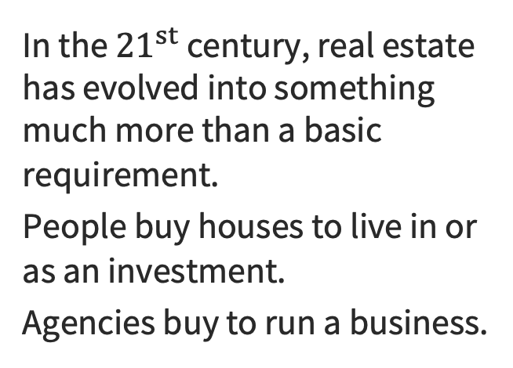
Introduction
Introduction

Slide 5

Motivation
Introduction
- A profitable investment since property values do not drop down quickly.
- Changes in the real estate price can affect various household investors, bankers, etc.
⇒ Predicting the real estate value is an important economic index.

Slide 6

Problem definition
Introduction
Estimating the value of real estate accurately is an important problem for many stakeholders.
There are many factors that affect the price such as size, number of rooms, etc.
Additionally, prices are sensitive to changes in market demand and the peculiarities of each situation.
Notes:
Accurately estimating the value of real estate is an important problem for many stakeholders including house owners, house buyers, agents, creditors, and investors. It is also a difficult one. Though it is common knowledge that factors such as the size, number of rooms and location affect the price, there are many other things at play. Additionally, prices are sensitive to changes in market demand and the peculiarities of each situation, such as when a property needs to be urgently sold.

Slide 7

Contribution
Introduction
Notes:
Our team will apply ML technique to build a model that can make accurate prediction on real estate price.

Slide 8
2.
Dataset

Slide 9


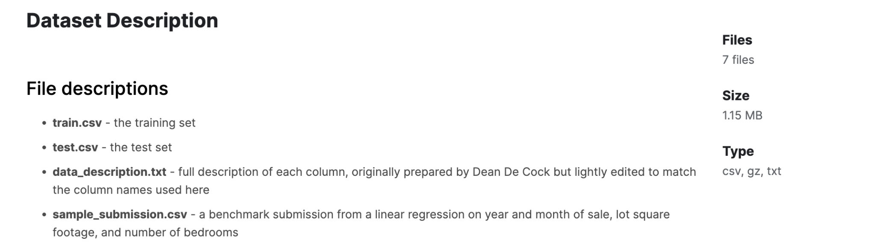
Dataset
Link

Slide 10
3.
Literature review

Slide 11
Literature Review
[1] Real Estate Price Prediction with Regression and Classification:
In this paper house prices are predicted using explanatory variables that cover many aspects of residential houses.
House prices are predicted with various regression techniques including Lasso, Ridge, SVM regression and Random Forest.
According to this paper, for a regression problem, the best-performing model is SVR with Gaussian kernel, with RMSE of 0.5271, however, visualization for SVR was difficult due to its high dimensionality.
According to its analysis, living area square feet, material of the roof and neighborhood have the greatest statistical significance in predicting a house’s sale price.
[CS 229 Autumn 2016 Project Final Report HujiaYu, Jiafu Wu [hujiay, jiafuwu]@stanford.edu].

Slide 12
Literature Review
[2] A SVR based forecasting approach for real estate price prediction:
The support vector machine (SVM) has been successfully applied to classification, cluster, and forecast.
This study proposes support vector regression (SVR) to forecast real estate prices in China. The aim of this paper was to examine the feasibility of SVR in real estate price prediction.
The experimental results were calculated based on the mean absolute error (MAE), the mean absolute percentage error (MAPE) and the root mean squared error (RMSE) and the SVR based approach was an efficient tool to forecast real estate prices.
[Hong Zhao,Rong-Qiu Chen, Wei Xu, Da-Ying Li Published in: 2009 International Conference on Machine Learning and Cybernetics].

Slide 13
Literature Review
[3] House Price Prediction Using Machine Learning and Neural Networks:
This paper aims to make evaluations based on every basic parameter that is considered while determining the price.
This model used various regression techniques in its pathway, and the results are not solely determined by one technique rather it is the weighted mean of various techniques to give the most accurate results.
The results proved that this approach yields minimum error and maximum accuracy than individual algorithms applied.
[Ayush Varma, Abhijit Sarma, Sagar Doshi, Rohini Nair, Computer Engineering Department, KJ Somaiya College Of Engineering, Mumbai, Published in 2018 Second International Conference on Inventive Communication and Computational Technologies (ICICCT)].

Slide 14
4.
Proposed solution

Slide 15
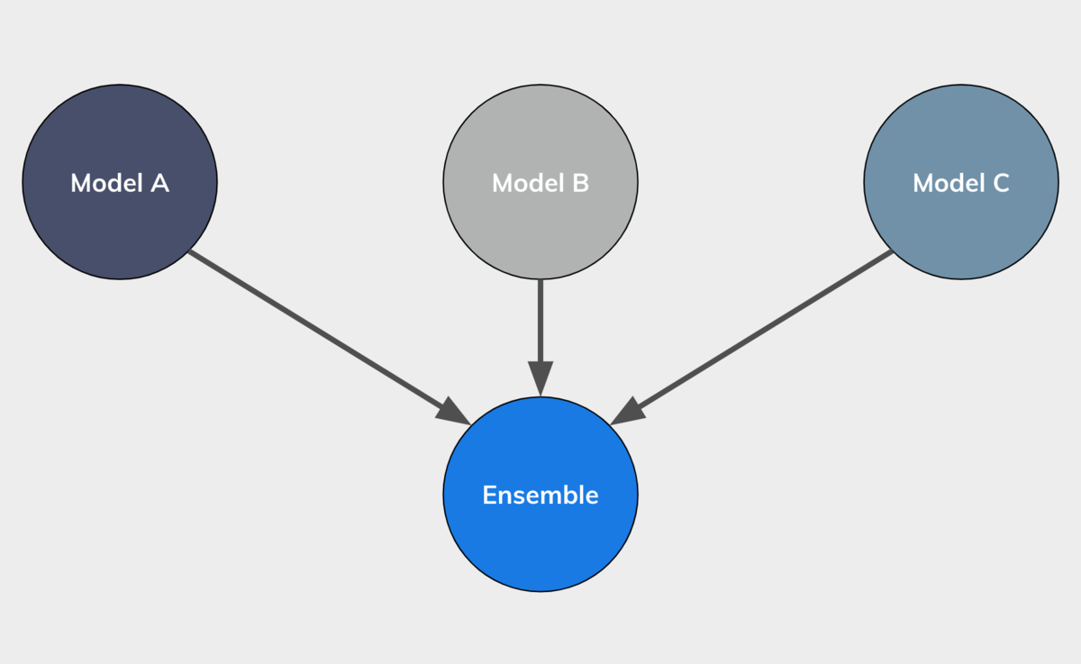
Ensemble models
Proposed solution
Combine decisions from multiple models to improve the overall performance.
Help tackle some complex machine learning problems.
Some popular ensemble techniques: Bagging, Boosting, Stacking & Blending.

Slide 16
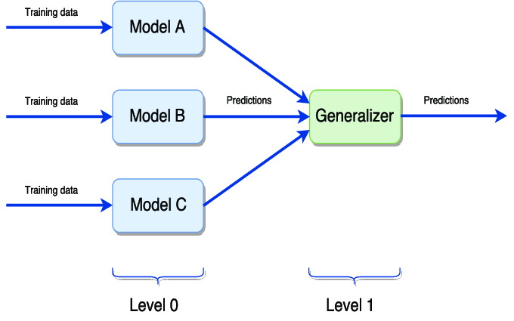
Stacking
Proposed solution
Use predictions from multiple models to build a new model.
Combine multiple classifications or regression models via a meta-classifier or a meta-regressor.

Slide 17
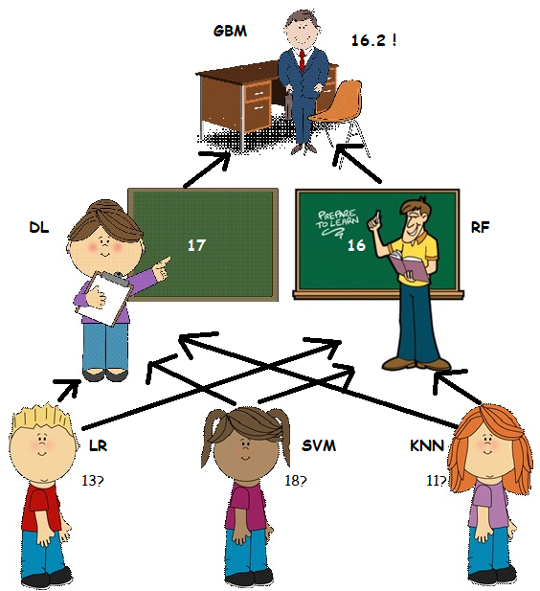
Why it works better?
Proposed solution
Each model has its own advantage.
New features created by using each model will help the meta model evaluate the performance of each model & select the best from each.

Slide 18
5.
Evaluation

Slide 19


Slide 20



Slide 21
Ridge | 13024,30315
Lasso | 13745,17695
ElasticNet | 13761,41700
StackingCVRegressor | 13887,71879
HistGradientBoosting | 14887,36899
LGBM | 14934,08367
XGB | 15249,13991
SVR | 15290,38134
GBR | 15510,19615
Tweedie | 17525,36899

Slide 22
Demo Time !

Slide 23
Thank you for listening!

Slide 24
References
Ha Nguyen, (15/06/2017), Stacking Made Easy: An Introduction to StackNet by Competitions Grandmaster Marios Michailidis (KazAnova), https://datasciblog.github.io/2017/06/15/stacking-made-easy-an-introduction-to-stacknet-by-competitions-grandmaster-marios-michailidis-kazanova/. Last accessed: 7:00, Dec 9th, 2022.

